Slide 1
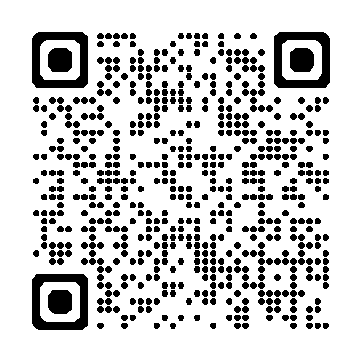
Winter 2026: Upcoming Workshops
Data Analysis Support Hub
March 4: Designing Complex Surveys with REDCap
March 10: Create an Interactive Dashboard using ArcGIS
Digital Research
February 26: Scholarly Podcasting: Voices, Stories, & Strategies
Research Data Management
February 19: Communities Empowered by Data 101: Tools and Best Practices
May 12: Data Management Plan Bootcamp (In-Person)
Do More with Digital Scholarship
February 25: Build Your Own Chatbot: Local Applications in Generative AI on your Laptop
March 19: Social Media Data! Practical and Ethical Collection, Visualization, and Management
Register for Upcoming Workshops: https://u.mcmaster.ca/scds-workshops

